Slide 1
DETECTION OF PHISHING WEBSITES USING MACHINE LEARNING

Slide 2
PRESENTATION OUTLINE
01
02
03
INTRODUCTION
STATEMENT OF PROBLEM
AIM AND OBJECTIVES

Slide 3
PRESENTATION OUTLINE
04
05
06
SCOPE OF STUDY
SIGNIFICANCE OF STUDY
METHODOLOGY

Slide 4
PRESENTATION OUTLINE
07
08
09
LITERATURE REVIEW
BENEFIT OF PROPOSED SYSTEM
EXISTING AND PROPOSED SYSTEM

Slide 5
PRESENTATION OUTLINE
10
11
12
CONCLUSION
SYSTEM DESIGN (Diagram)
IMPLEMENTATION & CONTRIBUTION TO KNOWLEDGE
REFERENCE

Slide 6

INTRODUCTION
The Internet global connectivity is regarded as a crossroads where users can meet and share information. This is the primary reason phishers choose this method of data exchange as a point of contact to conduct widespread phishing attacks by infecting computers with spyware that directs people to bogus websites.
Phishing attack is one of the most dangerous threats to online accounts and data because these attacks pose as a trustworthy firm or person, and they employ social engineering techniques to make victims more likely to fall for the scam.

Slide 7

STATEMENT OF PROBLEM
Phishing attacks have gotten increasingly complex, it is very difficult for an average person to determine if an email message link or website is legitimate. Cyber-attacks by criminals that employ phishing schemes are so prevalent and successful nowadays.
Hence, this project seeks to address fake URLs and domain names by identifying phishing website links. Therefore, having a web application that provides the user an interface to check if a URL is Phishing or legitimate will help decrease security risks to individuals and organizations.

Slide 8

AIM
The aim of this project is to detect phishing websites using machine learning and deep neural networks by developing a web application that allows users to check if a URL is phishing or legitimate and have access to resources to help tackle phishing attacks.
OBJECTIVES
i. dataset collection and pre-processing;
ii. machine learning model selection and development ;
iii. Comparsion of algorithm accurices and find thr best model;

Slide 9
SCOPE OF STUDY
This study explores machine learning models that uses datasets gotten from open-source platform to analyze website links and distinguish between phishing and legitimate URL links.
The model will be integrated into a web application, allowing a user to predict if a URL link is legitimate or phishing. This online application is compatible with a variety of browsers.

Slide 10
SIGNIFICANCE OF THE PROJECT
Due to the fraudulent websites built on the World Wide Web in the previous decade to mimic reputable websites and steal financial assets from users and organizations. Hence phishing attack has become so prevalent such that it has cost the internet community and other stakeholders hundreds of millions of dollars. Thus, robust countermeasures that can identify phishing are required.
These are the challenges to be addressed in this project:
I. Reduce the rate of financial theft from individuals and organizations online.
II. Educate Internet Users on the deception technique of phishers.
III. Educate Internet users on the countermeasures of phishing attack.

Slide 11

Image of Cyber attack Counter-measure

Slide 12




METHODOLOGY
An extensive review was done on existing works of literature and machine learning models on detecting phishing websites to best decide the classification models to solve the problem of detecting phishing websites.
Data Collection

Slide 13
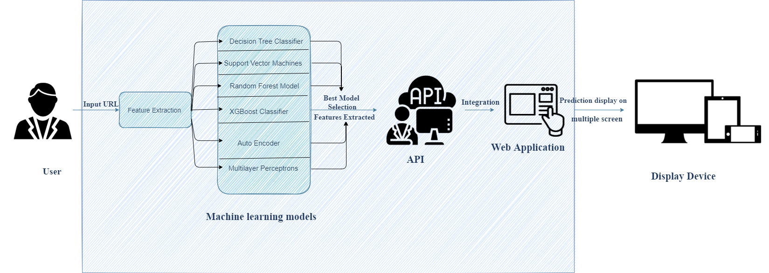
METHODOLOGY
Architectural design of proposed system

Slide 14
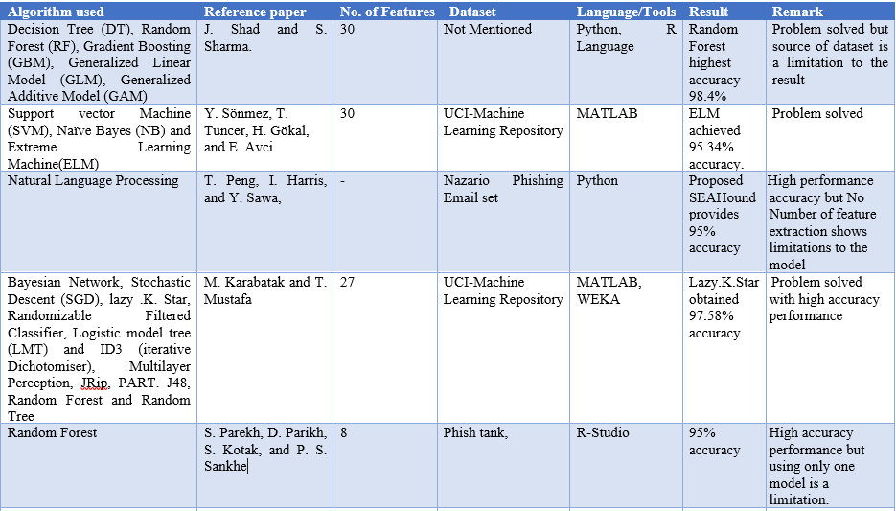
LITERATURE REVIEW

Slide 15
ANALYSIS OF EXISTING SYSTEM
The existing system of phishing detection techniques suffer low detection accuracy and high false alarm especially when different phishing approaches are introduced. Above and beyond, the most common technique used is the blacklist-based method which is inefficient in responding to emanating phishing attacks since registering new domain has become easier, no comprehensive blacklist can ensure a perfect up-to-date database for phishing detection.

Slide 16
ANALYSIS OF PROPOSED SYSTEM
The proposed phishing detection system utilizes different machine learning models. The system, which are the machine learning models . These models consist of Decision Tree, Support Vector Machine, Logistic Regression,KNN,Random Forest.
These models are selected after different comparison based performance of multiple machine learning algorithms. Each of these models is trained and tested on at last content-based feature, extracted from both phishing and legitimate dataset.
Hence, the model with the highest accuracy is selected.It is best Model

Slide 17

BENEFIT OF PROPOSED SYSTEM
Will be able to differentiate between phishing(0) and legitimate(1) URLs
Will help reduce phishing data breach for organization
Will be helpful to individuals and organizations
Will be easy to use
(Source: Credibly, n.d.)

Slide 18
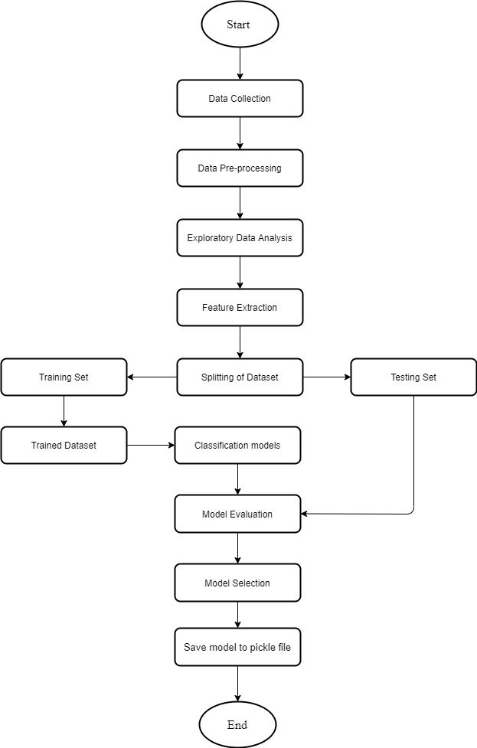
Machine Learning process

Slide 19
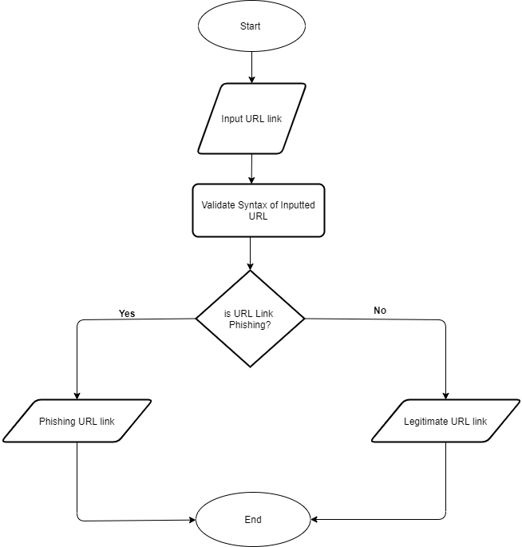
Flowchart of Web Application

Slide 20
Implementation

Slide 21
RESULTS

Slide 22
COMPARSION OF ALGORITHMS

Slide 23

CONTRIBUTION TO KNOWLEDGE
This project provides an efficient and effective way for detecting phishing websites (URL) by exploring Data science classification technique.
This project tend to improve the previous technique for detecting phishing websites by employing different machine learning classification models to distinguish between phishing and legitimate URL links.
Hence, This project provides a new and faster way to help users detect if a URL link is phishing or legitimate and also provide them access to educational resources about phishing attacks.

Slide 24

CONCLUSION
The contribution of this research work is to help both individuals and organization identify and understand phishing techniques used by phisher as well as help them detect phishing URL attack effectively and efficiently by employing machine learning models instead of the previous method of detecting phishing website.

Slide 25
Recommendation
Through this project, one can know a lot about phishing attacks and how to prevent them. This project can be taken further by creating a Web Application to detect phishing URL Links.

Slide 26
REFERENCES
Cyber attacker hacking into email server by Freepik. (n.d.). Retrieved from https://www.freepik.com/free-vector/cyber-attacker-hacking-into-email-server_5259895.htm#page=1&query=cyber%20phishing&position=2
People connecting jigsaw pieces of a head together by Freepik. (n.d.). Retrieved from https://www.freepik.com/free-vector/people-connecting-jigsaw-pieces-head-together_3425145.htm#page=1&query=knowledge&position=4
Group of people holding question mark icons by Freepik. (n.d.). Retrieved from https://www.freepik.com/free-vector/group-people-holding-question-mark-icons_3530048.htm#page=1&query=PROBLEM&position=12
Golden cup with arrow hitting in the target center by Freepik. (n.d.). Retrieved from https://www.freepik.com/free-vector/golden-cup-with-arrow-hitting-target-center_1311358.htm#page=1&query=AIM&position=25
Affective computing abstract concept illustration by Freepik. (n.d.).Retrieved from https://www.freepik.com/free-vector/affective-computing-abstract-concept-illustration_11668804.htm#page=1&query=machine%20learning&position=17

Slide 27

THANKS FOR LISTENING

